Slide 1


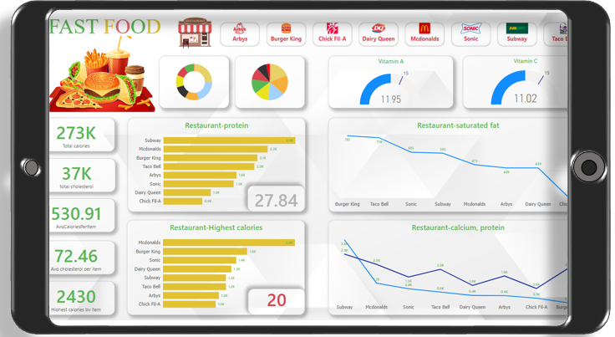
CDACL-004
FAST FOOD
ANALYSIS
SUVINESH M
DATA ANALYST

Slide 2

INTRODUCTION
This project studies menu items from eight fast food restaurants, focusing on nutritional attributes like calories, fats, sodium, total fat, fat from calories, saturated fat and protein. Using SQL and Power BI, I identified trends in ingredient distribution and health impacts, offering insights for better menu optimization and consumer choices.
Skills applied
Tools used
Data fetching & enhancing
Power Query
Exploratory Data Analysis (EDA
Dax
Data visualization techniques
MySQL
Power BI

Slide 3
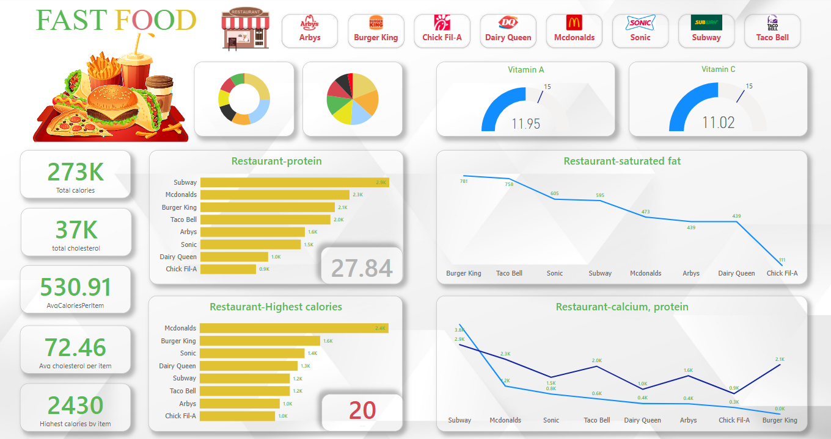
Dashboard view

Slide 4
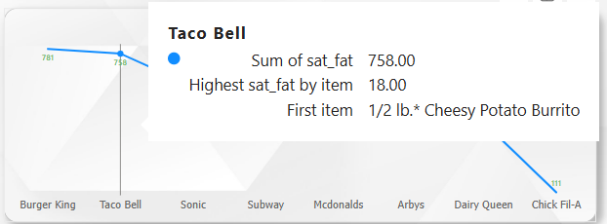
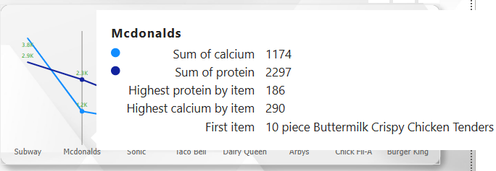
Line chart with tooltip
Created a line chart to visualize saturated fat levels across restaurants, making it easy to identify differences.
Added tooltips to show which menu items contribute the most to high saturated fat values.
Highlighted the food item with the highest saturated fat value, ensuring clarity in analysis.
(For Example): Here Mcdonalds creates the second highest Calcium and protein contained food item.
,Highest protein 186 and calcium 290 from
“10 piece Buttermilk crispy chicken tenders”

Slide 5
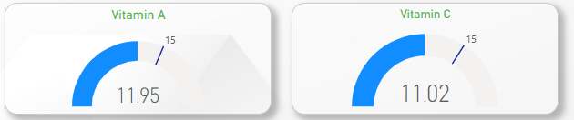


Vitamin A : Average value – 11.00
Target: 15.00
Vitamin C : Average value – 11.00
Target: 15.00
Pie chart :
Burger king regulates (25.26%) of trans_fat which highest values per item is (8.00)
Burger king regulates (19%) of calories from fat which highest values per item is (1134)
“20 piece chicken Nuggets”
(Vitamin’s and other analysis vary on restaurants that is in slicer button)

Slide 6
Conclusion
Nutritional values vary significantly across fast food restaurants, with some items containing excessive calories, fats, and sodium.
The analysis highlights the importance of mindful consumption and the impact of fast food choices on overall health.
Healthier alternatives or nutrient-balanced meals should be considered to reduce the risks associated with excessive fast food consumption.
Fast food should be consumed in moderation due to high saturated fat, sodium, and calorie content.
Burger King ranks second highest in calories and highest in saturated fat and calories from fat, making it a less favorable option.
It also has lower levels of vitamins and protein, reinforcing the need to avoid or limit its menu choices for better nutritional balance.
suggestion

Slide 7

View in power BI
Thank you
END

